Slide 1
FUNDAMENTALS OF DATABASE SYSTEMS
IMPLEMENTING DATABASES AND RELATIONSHIPS
Aditya Garg | 2018214
Anshul Raj | 2018020
Jasmine Kaur | 2018287
Mayank Joshi | 2018048
Ujjwal Singh | 2018113

Slide 2
The agenda is to develop the back-end of an
online store that requires extensive use of data entities selection, their relationships, data modeling and manipulation, and database access.
Agenda
Agenda

Slide 3
Notes
Students often feel that lecture slides/ course materials are not enough while preparing but most of them don’t make notes.
Clubs
Students are a part of various things outside academia but newcomers feel like outsiders and unwelcome and unaware.
Interests
With the increasing use of social media, everyone has accounts on all platforms but many don’t know the ones around them. IIIT culture teaches that everyone knows everyone.
Portfolio building
Academics are not the only way to secure a successful future, what happens outside the classroom is proven to be important.
Collaboration
In the real world, individuals barely ever work together. Learning to work with teams is an important learning experience.

Slide 4
Sharing notes, papers, cheat sheets, books
Clubs Association
An integrated platform for students
Project collaboration
Online courses
Interests and portfolio development
Social Integration
Increase in convenience
An internal network
and productivity

Slide 5
There is a gap between the students in the previously stated areas and there is a need to reduce it.
The solution will help bring forward an integrated platform for the students of IIIT Delhi to exploit.

Slide 6
Existing solutions
Existing Solutions

Slide 7





Employment-oriented service for professional networking, employers posting jobs and job seekers posting their CVs.
A video sharing service.
Social news aggregation, web content rating, and discussion website.
A place to read and write big ideas and important stories.
Online learning community. Courses focus on interaction and learning by completing a project
Pros
Easy to communicate
Make connections
Targeted searches
Participation in professional groups and organizations
Jobs & skill specific content
Personal messaging
Cons
The network is worldwide, does not cater to specific students only
Pros
Subscribers, subs feed
Video management on the go
360 degree videos
Captures attention well
Helps students with concepts
Cons
Lots of irrelevant info
Fake content fake skill selling
Pros
Upvotes and downvotes to identify good and bad posts
Karma points to prevent spammers
Customer service
Promotes learning
Cons
Text based
Becomes hard to find information
Pros
Original content
VIew user stats
Audio articles
Dark and light theme
Tags to categorize content
Cons
Fails to capture a lot of attention
Lots of text
No vlogs
No specific info
Pros
Discover and filter project based classes
Classes synced across web and mobile
Project based learning
Skill specific learning
Cons
Paid courses
Limited language options
Limited facilities for non creative courses

Slide 8
Interviews
Interviews
The interviews were conducted in-person and over the telephone both and of students pursuing Btech, Mtech and PHD in IIIT Delhi.

Slide 9
Around how many people in college are you familiar with?
Where do you find out what online courses will help you?
Do you make notes? If no, what references do you use?
While facing operational issues in college, what do you do?
Questions
Have you faced difficulty in getting jobs/internships? If yes, who helps you out?
What all do you do to develop your skills/ portfolio?
Course?
Are you a part of any clubs in college? How did you find out about them?
How do you acquire new skills? What are some of the apps and websites you use the most to learn new skills?

Slide 10
The ideas were now narrowed down and the sketch of the platform started taking shape.

Slide 11
Problem Statement
Problem Statement
There is a lack of awareness about opportunities in the college itself. Moreover, the students don’t have a medium to trade things or collaborate. This is leading to a weaker college network.

Slide 12
The Solution
The Solution
The motive is to make a network “for the students, of the students, by the students” of IIITD.
The network connects the students with each other, with clubs and societies and to various online resources recommended by students.

Slide 13
Skill Trading happens through clubs and resources like blogs and videos that fellow students recommend. Users can share videos and update their content regularly to offer continuously evolving skills. Skills can be of any form ranging from Artificial intelligence to literary or performing arts.
The platform helps engage trade of notes and self made resources that students make for their courses that can be uploaded on their profiles.
Services like FMS and other portals like Library can be linked to the same platform to increase convenience as a part of the future plan, the way forward.

Slide 14
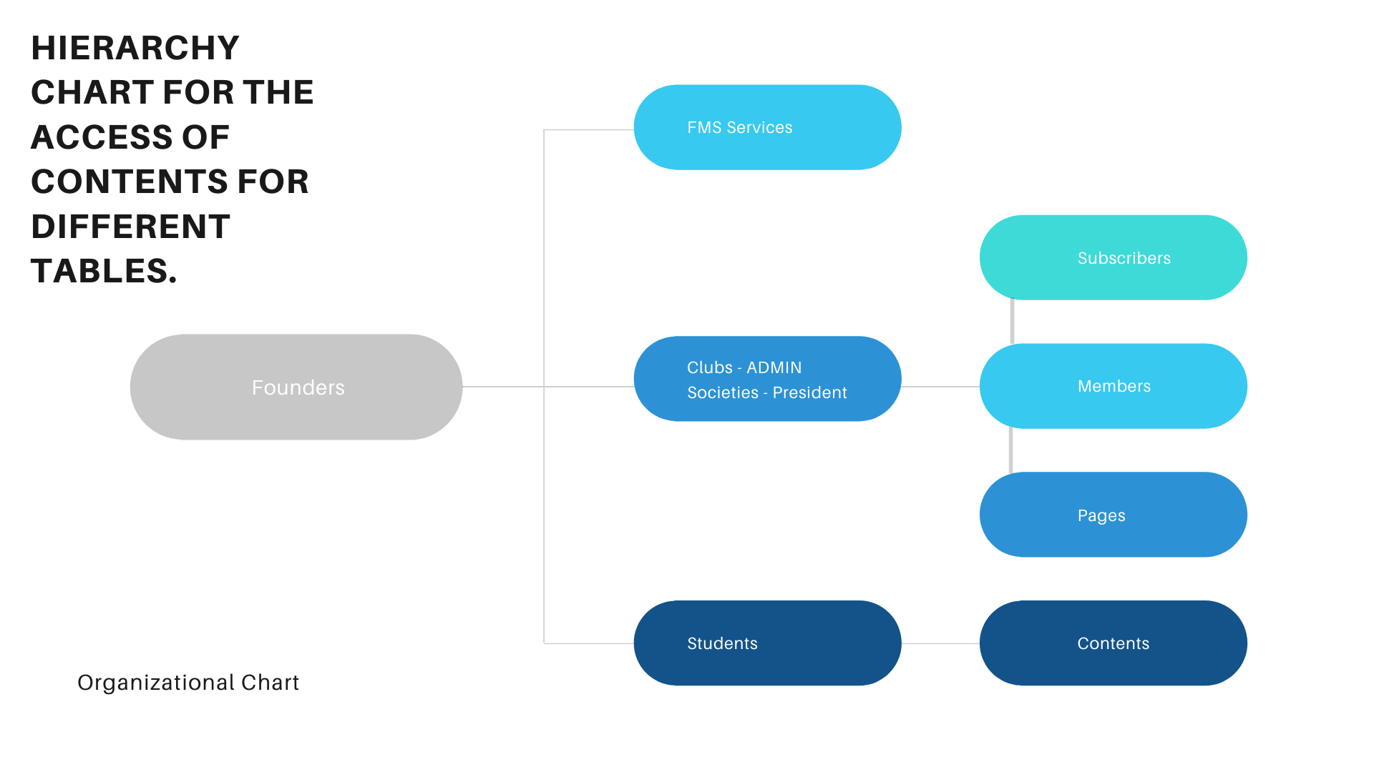
Who is the solution catering to
Who is the solution catering to

Slide 15
Name
Name
Associate

Slide 16
Tagline
Tagline
Connect. Develop. Succeed.

Slide 17
Stakeholders
Stakeholders

Slide 18
PHD
BTech
MTech
The students
Clubs and committees
Stakeholders
Publishers
Advertisers
Services in college
Bloggers
FMS
Online course platforms

Slide 19
The Students
The Students
How do you acquire new skills? What are some of the apps and websites you use the most to learn new skills?
Do you make notes? If no, what references do you use?
Are you a part of any clubs in college? How did you find out about them?
What all do you do to develop your skills/ portfolio?
While facing operational issues in college, what do you do?

Slide 20
Clubs and Committees
Clubs and Committees
What is your selection process for new members?
What are the most frequently asked questions by non-members?
Do you maintain a calendar of your upcoming events? If yes, Who all has access to it?
Does your activity/ work contribute towards any specific skill development?
What is your preferred medium of communication to reach out to the students/ the members?

Slide 21
Services in college
Services in college
How often do students contact you/ require your services?
What is your preferred medium of communication to reach out to the students?
What medium of communication do students prefer to get in touch with you?
How do you categorise complains/ requests?
How do you take reviews of the services?

Slide 22
Advertisers
Advertisers
What services products does your company provide?
What is your main target audience?
How do you generally reach out to students?
What services/ products does your company provide to students?
What is your existing mode of communication with your target audience?

Slide 23
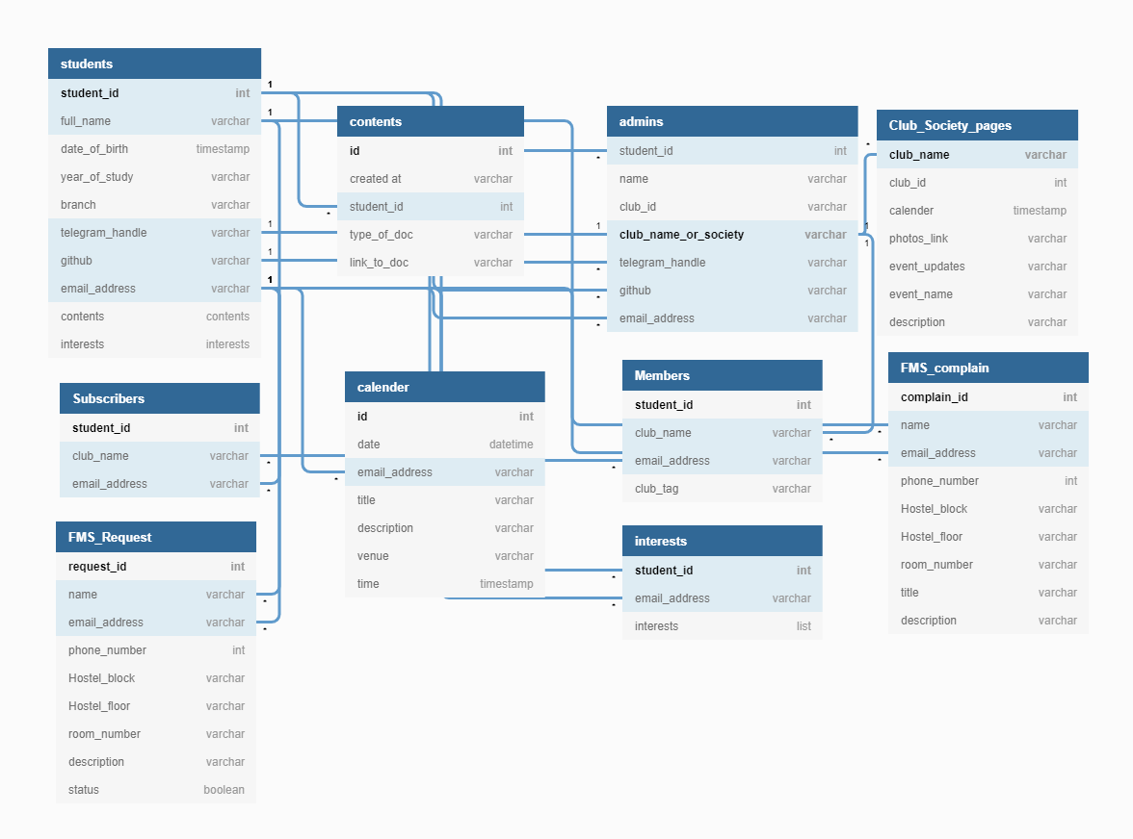
Schema
Schema

Slide 24
Understanding the solution
Understanding the solution

Slide 25
Students
Students
The heart of our project is Student’s and we have got something special for them. The students can make their personal profiles listing their information such as name, email, telegram_link, etc. Not only this the students can upload their personal stuff such as notes, books, online resources, etc. along with the other users. The students can subscribe to club_pages to receive updates from them. The students can even make request and complain to FMS directly from our platform.
Need updates?
Get to know what interesting work your fellow mates are upto by checking their feeds.
Want help?
Just ping your seniors and ask all your doubts. Find the best senior for your problem by looking at their skillset/interests.
Willing to help?
There are surely a lot of students out there who need your guidance when they are stuck at something. Be their helping hand by sharing your experiences.

Slide 26
Want to share your resources to others?
The students can now share resources/contents such as Notes, online resources under specified categories directly to others by uploading it on their personal profiles. The other students can then view them or download them from their profiles. The students can even sort the resources by topics such as Advanced Programming, Ada etc. and it sorts according to their rating (we have devised a way to rate them).
Increases Interaction among the students?
The students can interact with other students through resource sharing and taking guidance from others regarding a common topic thus increasing the interaction among fellow students.
Helps with academics? Sharing resources and taking guidance from others helps people perform well in academics as well.
Member of some exclusive club?
We won’t stop you from bragging your achievements and memberships. There is a special tag for each club member that would make your profile noteworthy.

Slide 27
Clubs and Committees
Clubs and Committees
Our System will provide a very effective yet simple way for clubs/council to reach other students, via announcements, calender or interact with the club representatives directly. These are some of the areas where we will be helping.
Reaching out to new students?
=> Clubs can reach new students via there page and accumulate followers.
Data Entities - Club_Society_Pages, Students, subscribers
Making Announcements?
=> Clubs can make announcements on their page which will reach their followers via a notification
Data Entities - Club_Society_pages, Members, calendar, students
Organizing Events?
=> Clubs can easily organize events and collect volunteers as per there requirements if needed by looking at the interests/expertise of an individual on his/her account or just roll out a form via announcements.
Data Entities - Club_Society_pages, Students, Members,Subscribers

Slide 28
Increasing Student Interaction?
=> students can directly interact with the club admins/members as a badge will appear on an account if they are part of any club or hold any position of responsibility.
Data Entities - Club_Society_pages, Students, Subscribers
Organized common calendar?
=> Our application will offer an organized calendar that the clubs can edit and add events on it. They can also be able to add event-related information such as description, time, venue of a event which will also trigger a notification for the followers. This calendar will be available to all the students by displaying all the events from all the clubs.
Data Entities - Club_Society_pages, Calendar, Students.
We will be having different pages for clubs and council each handled by their respective admins.
Only the admin has permission to post or edit the content on the page.
Members can only be added or removed by the admin of that particular club.
For every post made or event added to the calendar, a notification will be sent to the followers of that particular page regarding the same.
Each page has there own database which can be edited by only the respective presidents.

Slide 29
Subscribers
Subscribers
Our System will provide a very effective yet simple way for clubs/council to reach other students, via announcements, calender or interact with the club representatives directly. These are some of the areas where we will be helping.
Reaching out to new students?
=> Clubs can reach new students via there page and accumulate followers.
Data Entities - Club_Society_Pages, Students, subscribers
Making Announcements?
=> Clubs can make announcements on their page which will reach their followers via a notification
Data Entities - Club_Society_pages, Members, calendar, students
Organizing Events?
=> Clubs can easily organize events and collect volunteers as per there requirements if needed by looking at the interests/expertise of an individual on his/her account or just roll out a form via announcements.
Data Entities - Club_Society_pages, Students, Members,Subscribers

Slide 30
FMS Facilities
FMS Facilities
Do you want to make a complaint/request to the FMS and fed up of the whatsapp system and waiting for reply. Our platform takes care of that as well. The students can file a complaint against some problems handled by the Fms. Not only this the students can now request a service such as cleaning, ac service from the Fms directly through our platform.
Want to file a complaint?
The students can file a complaint anonymously directly from our platform so that the Fms can start to improve it as soon as possible.
The FMS does not respond to the Whatsapp message?
The students now need not to apply for the request such as cleaning etc on whatsapp. They can directly request from our site. And we make sure the Fms responds to request as soon as possible. Making the process a lot easier.
Get regular updates from FMS as well?
The Fms can send you updates such as fire drills, watercooler cleaning, Net-speed down etc. to the students directly through our platform. Reduces those unnecessary emails for this from the hostel department.

Slide 31
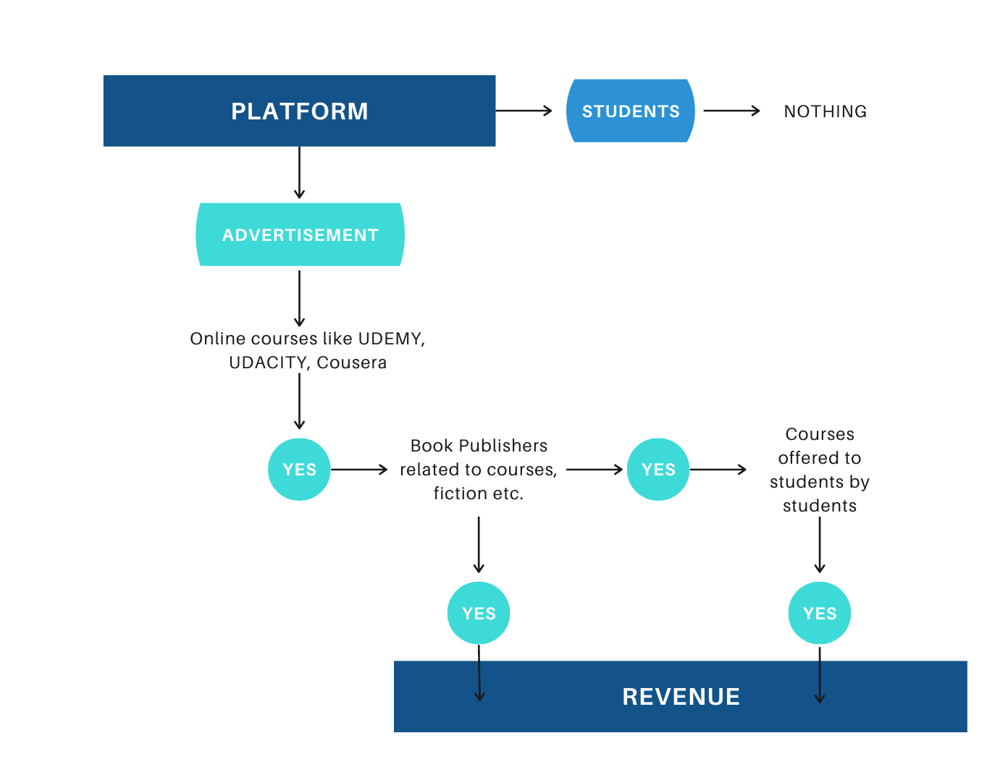
Revenue Model
Revenue Model

Slide 32
Updated Database Tables
Updated Database Tables

Slide 33
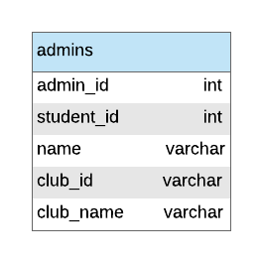
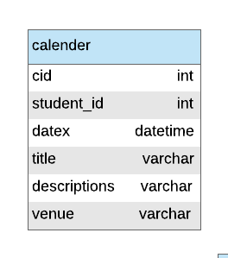
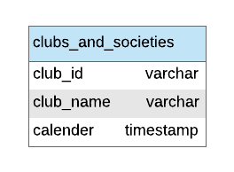
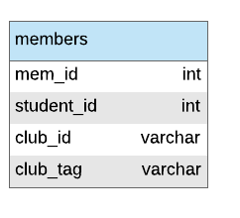
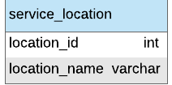
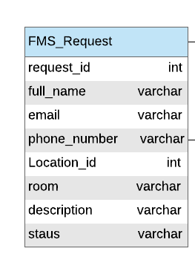
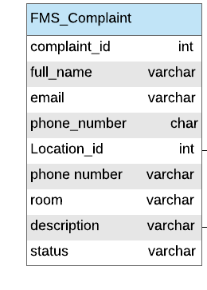
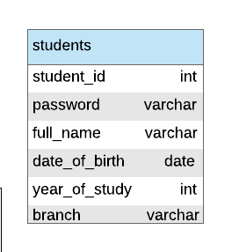
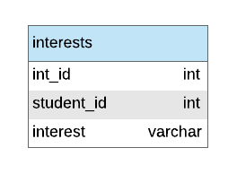
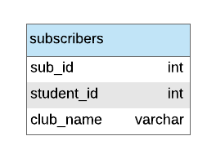

Slide 34
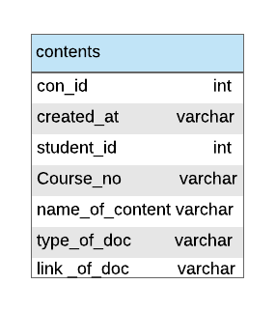
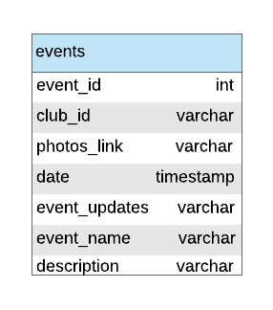
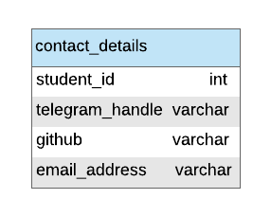
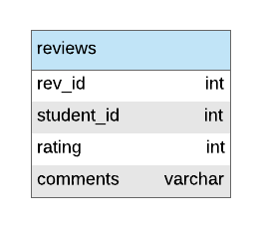

Slide 35
Entity Relationship Diagram
Entity Relationship Diagram

Slide 36
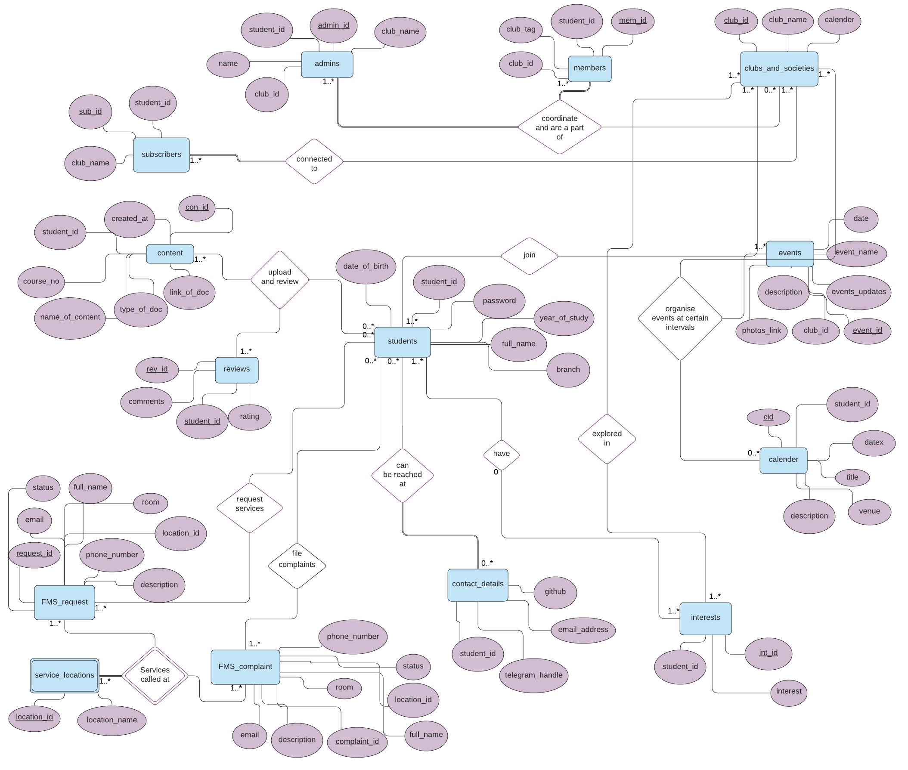

Slide 37
Embedded Queries
Embedded Queries

Slide 38
Students
Students
1. Get students with a particular skill/Interest:
def get_skill(skill,Roll_No=-1):
SELECT data.student_id, data.full_name, data.year_of_study, data.branch, contact.telegram_handle, contact.github, contact.email_address FROM (
SELECT s.student_id, s.full_name, s.year_of_study, s.branch
FROM students s, interests i
WHERE i.student_id = s.student_id and i.interest= {Enter Text})
data LEFT JOIN contact_details contact ON data.student_id = contact.student_id ;
2. Upload a particular document:
def upload_doc(Roll_No,course_no, name_of_content,type_of_doc,link):
INSERT INTO contents VALUES
(null,{Time},{Roll NO},
{Name of content},{Doc Type},{Link});
3. Show document related to a particular course:
def find_by_course(course):
SELECT *
FROM contents
Where course_no = {Text};

Slide 39
Students
Students
4. View admins of all the clubs:
def view_admins():
SELECT a.student_id, a.name, a.club_id, a.club_name, c.telegram_handle, c.github, c.email_address From admins a
LEFT JOIN contact_details c
ON a.student_id = c.student_id ;
5. Update your contact details.
def update_contact(Roll_No,tele,github):
UPDATE contact_details
SET telegram_handle = {Enter Text}, email_address = {Enter Text}, github = {Enter Text}
WHERE student_id = {Enter Text};
6. Search for a particular person by his/her roll no.
def search_by_roll(Roll_No):
SELECT student_id, year_of_study, branch
FROM students
WHERE student_id = {Enter Text};
7. View all interest of a person
def profile_data(Roll_No):
SELECT interest
FROM INTEREST
WHERE student_id = {Enter Text};

Slide 40
Students
Students
8. View all the clubs of a given person:
def profile_data(Roll_No):
SELECT *
FROM members
WHERE student_id = {Enter Text};
9. Verify the credentials of a user:
def verify_cerdential(Roll_No, password):
SELECT COUNT(*)
FROM students
WHERE student_id = {Enter Text} and password = {Enter Text};"
10. Change Password of a particular user:
def change_pass(Roll_No, password):
// to be done after forgot password
UPDATE students
SET
password = {Enter Text}
WHERE student_id = {Enter Text};

Slide 41
Interests
Interests
1. Number of students for each interest.
def interest_popularity():
select interests.interest,count (students.student_id)
from students,interests where students.student_id = interests.student_id
group by interests.interest;
2. Number of students with different interests in different branches.
def branch_interest():
select students.branch, interests.interest,count (students.student_id)
from students,interests where students.student_id = interests.student_id
group by students.branch,interests.interest;

Slide 42
FMS
FMS
1. Resolve requests/ complaints from FMS end
def resolve_FMS(request_id,isRequest = False):
UPDATE FMS_{} SET Status = “Yes” WHERE request_id = %s;
2. Cancel FMS request
def cancel_FMS(req_Id):
DELETE FROM FMS_Request
WHERE request_Id = {Enter Text};
3. Make a new FMS request.
def new_FMS_req_comp(Name,Email,Phone, Location_ID,Room,Description,isRequest = False):
INSERT INTO FMS_Request VALUES
(NULL,{NAME},{EMAIL},{Phone},{Location Id},{Room No},{Description},”No”);
4. Know status about your FMS complaint/request.
def status_FMS(email):
SELECT request_ID,Phone_Number, Location_ID,Room,Description,Status FROM FMS_Request WHERE Email = %s;
or
SELECT complaint_ID,Phone_Number, Location_ID,Room,Description,Status FROM FMS_complaint WHERE Email = %s;
5. Make a new FMS complaint.
def new_FMS_req_comp(Name,Email,Phone, Location_ID,Room,Description,isRequest = False):
INSERT INTO FMS_Complaint VALUES (NULL,{NAME},{EMAIL},{Phone},{Location Id},{Room No},{Description},”No”);

Slide 43
Clubs and Societies
Clubs and Societies
1. Number of students for each club:-
def popular_club():
select count(M.student_id), C.club_name
from members M,clubs_and_societies C
where M.club_id = C.club_id
group by M.club_id
order by count(M.student_id) DESC;
2. Select students with a particular tag:
def search_Tag(tag):
select student_id from members M
where M.club_tag = "Text";
3. Add a entry into the calendar:
def insert_to_calender(Roll_No,DateTime,Title, Description,Venue):
insert into calender values (NULL,{Roll_no},{Date Time},{Title},{Description},{Room});
Sample Example- (NULL,"2018275","2020-01-31 23:23:45","Dance Competition","Random Desc-1","C-101");
4. Give all the events of a particular student from his calender on a particular date:
def get_events(Roll_No,date):
SELECT title, descriptions, venue
FROM calender C WHERE C.student_id = %s AND Date(C.datex) = %s;

Slide 44
Clubs and Societies
Clubs and Societies
5. Show all the uploaded contents of a particular student:
def show_uploads(Roll_No):
Drop view if exist contentx;
CREATE VIEW contentx as SELECT student_id,created_at,name_of_content,type_of_doc,link_of_doc FROM contents;
select * from contentx C where C.student_id = "2018275";
6. Lists of clubs a particular student have subscribed to:
def show_Subscribed(Roll_No):
select club_name
from Subscribers S
where student_id = “TEXT”;
7. Reviews given to the files uploaded by a particular student:
def reviews_to_me(Roll_No):
select R.rev_id,R.student_id as Reviewer,R.rating,R.comments,C.name_of_content, C.student_id as Uploader from contents C, reviews R
where C.student_id = "Text" and R.rev_id = C.con_id;

Slide 45
Clubs and Societies
Clubs and Societies
8. Average ratings of all the contents which at least have 1 rating given to it:
def avg_rating_all():
select avg(R.rating),R.rev_id,
C.name_of_content,C.course_no,C.student_id as Uploader from reviews R, contents C
where rev_id = con_id
group by R.rev_id order by avg(R.rating) DESC;
9. Average rating of the contents uploaded by a particular student:
def avg_rating_my(Roll_No):
select avg(R.rating),R.rev_id, C.name_of_content,C.course_no,C.student_id
as Uploader from reviews R, contents C
where rev_id = con_id and C.student_id = "Text"
group by R.rev_id order by avg(R.rating) DESC;
10. Average rating query with variance also:
def avg_rating_my(Roll_No):
select variance(R.rating),avg(R.rating), R.rev_id,C.name_of_content,C.student_id as uploader from reviews R, contents C
where rev_id = con_id and C.student_id = "2018279" group by R.rev_id;

Slide 46
Relational Algebra Queries
Relational Algebra Queries

Slide 47
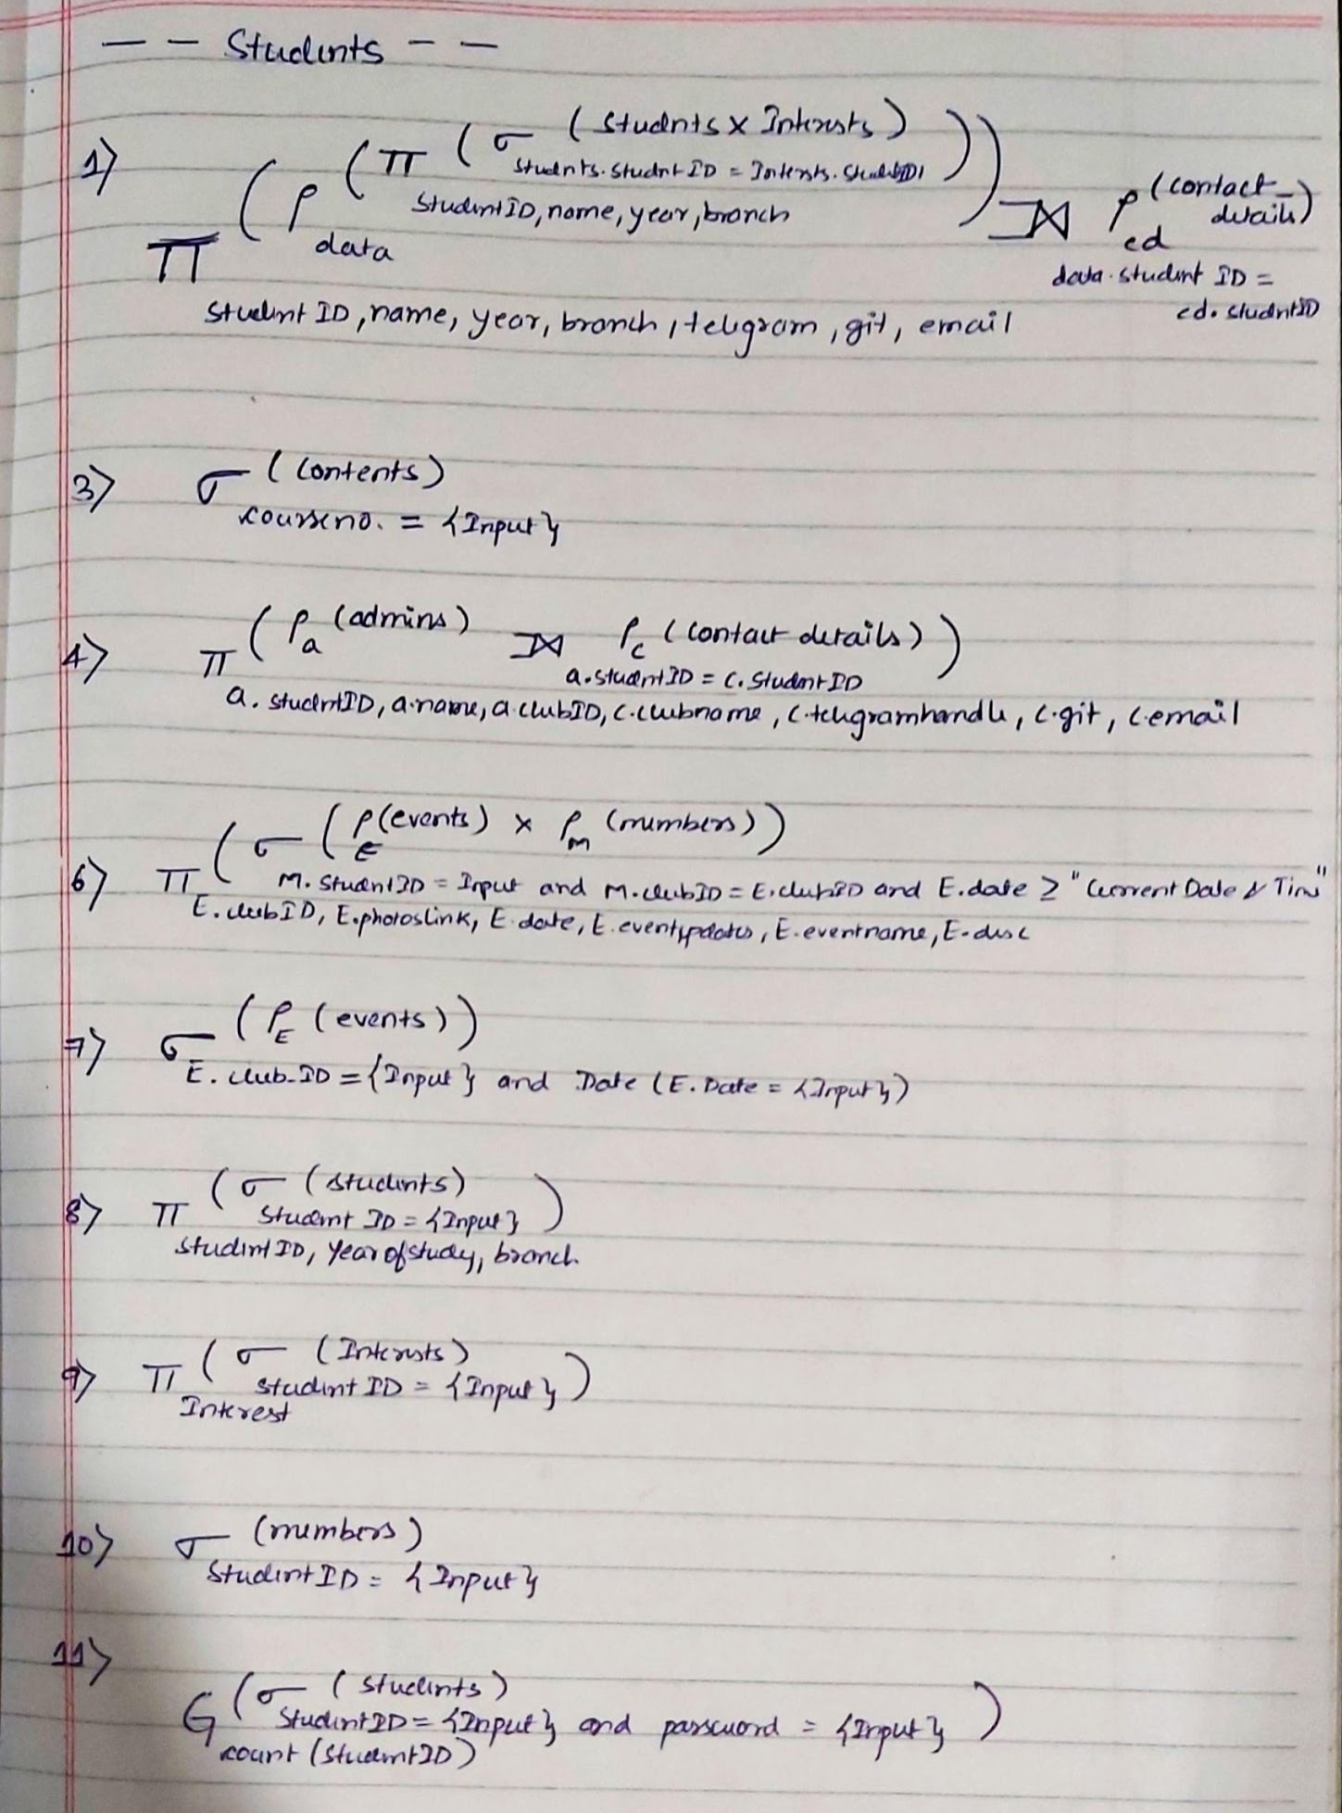

Slide 48
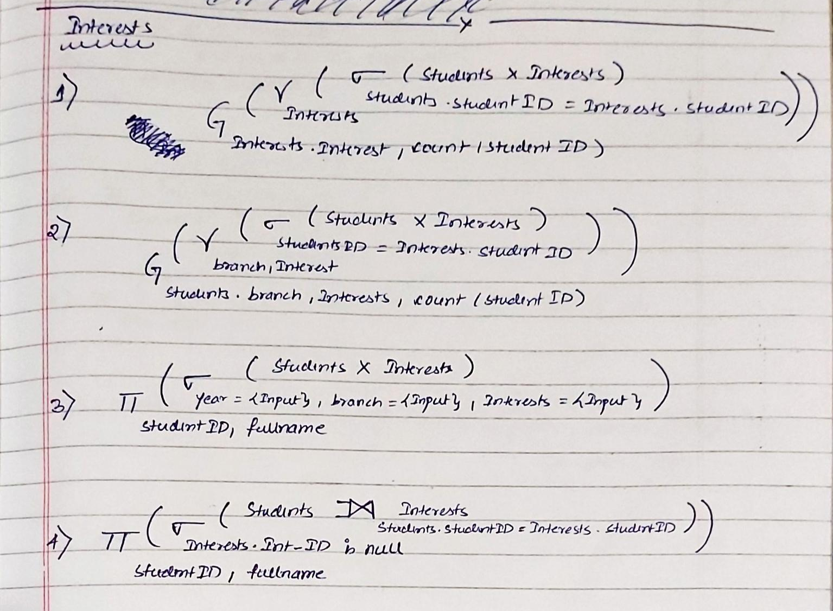

Slide 49
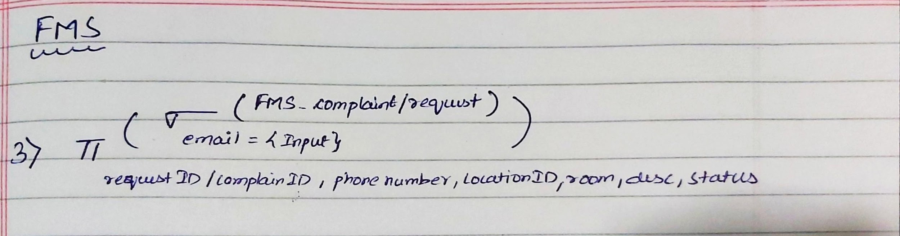
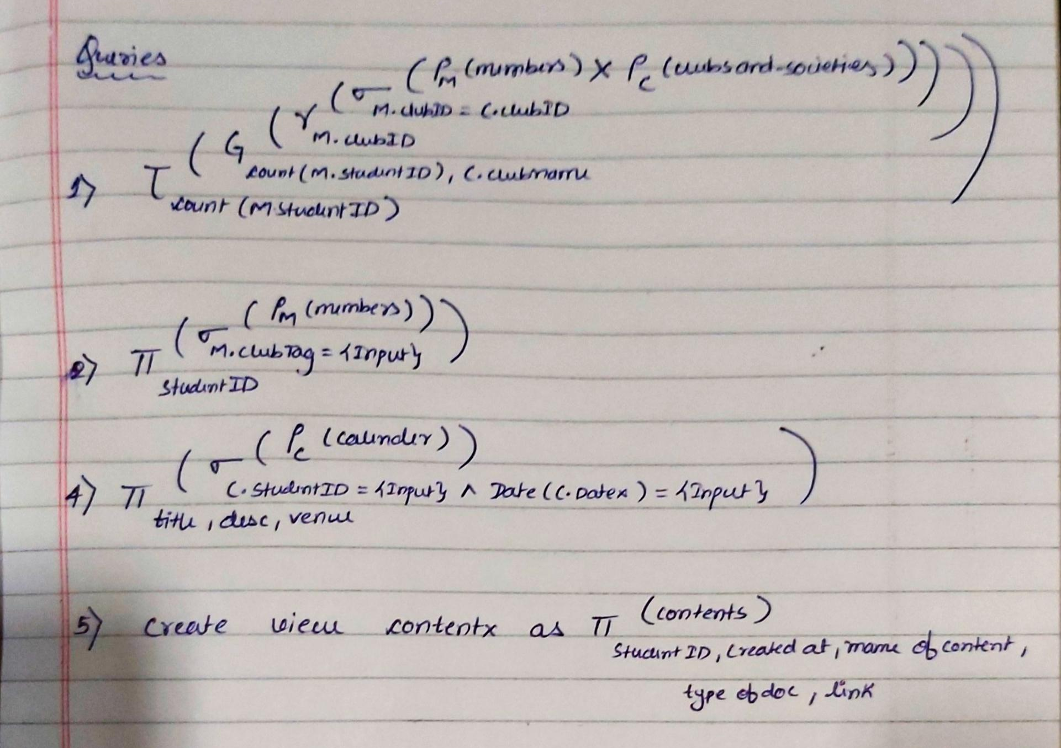

Slide 50
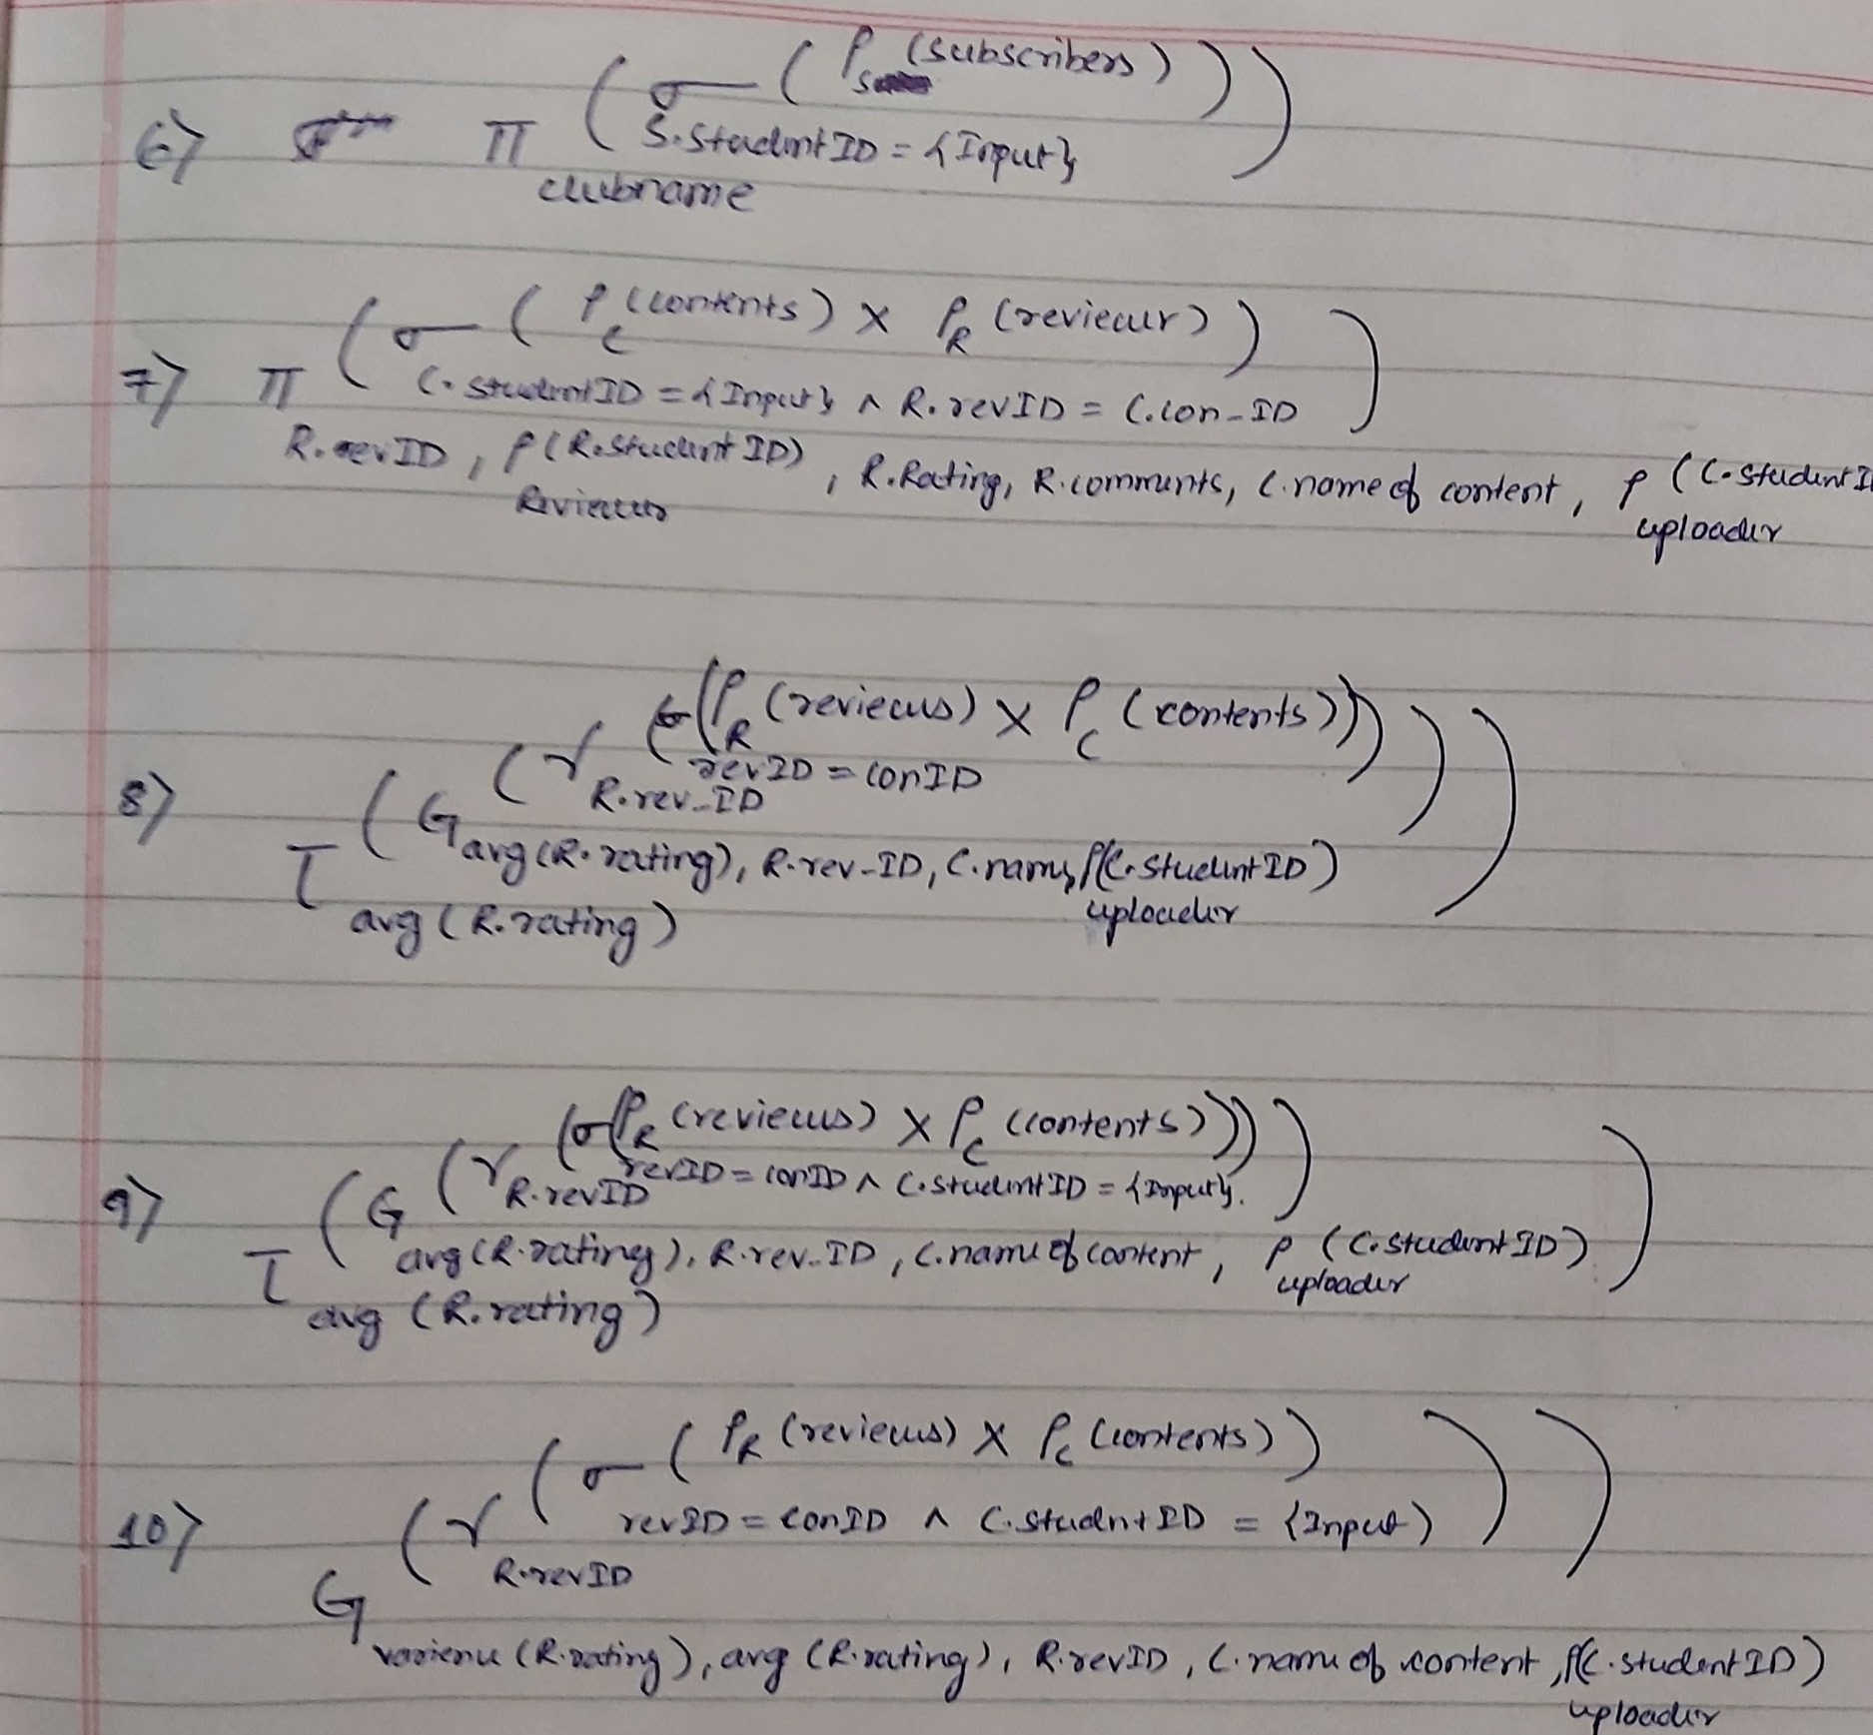

Slide 51
Bonus Features in the project
Bonus Features in the project
An integrated chat system for students of IIITD to connect with each other
A user friendly and easy-to-use and access front end.
Inbuilt video conferencing for the students.
Backend support for data is enabled and backed up.

